Slide 1
How to compute a derivative

Slide 2
Computing derivatives of complicated functions
How do you compute the derivatives in an LSTM or GRU cell?
How do you compute derivatives of complicated functions in general
In these slides we will give you some hints
In the slides we will assume vector functions and vector activations
But we will also give you scalar versions of the equations to provide intuition
The two sets will be almost identical, except that when we deal with vector functions
The notation becomes uglier and less intuitive
We must ensure that the dimensions come out right
Please compare vector versions of equations to their scalar counterparts for better intuition, if needed

Slide 3
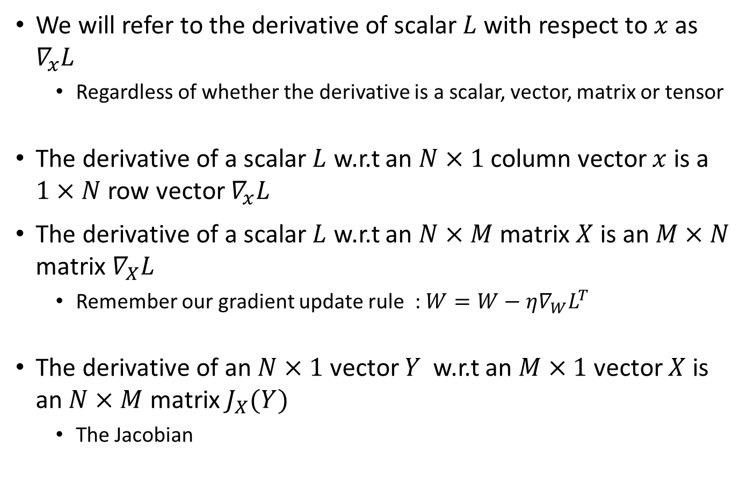
First: Some notation and conventions
We will refer to the derivative of scalar $L$ with respect to $x$ as $∇_{x}L$
Regardless of whether the derivative is a scalar, vector, matrix or tensor
The derivative of a scalar $L$ w.r.t an $N×1$ column vector $x$ is a $1×N$ row vector $∇_{x}L$
The derivative of a scalar $L$ w.r.t an $N×M$ matrix $X$ is an $M×N$ matrix $∇_{X}L$
Remember our gradient update rule : $W=W−{η∇_{W}L}^{T}$
The derivative of an $N×1$ vector $Y$ w.r.t an $M×1$ vector $X$ is an $N×M$ matrix $J_{X}(Y)$
The Jacobian

Slide 4
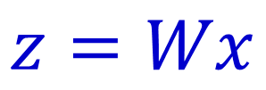
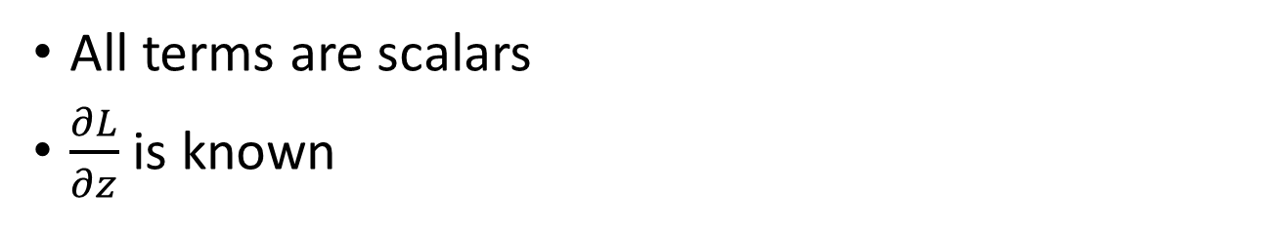
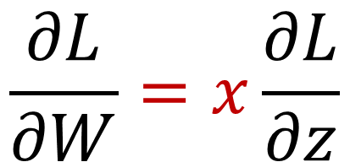
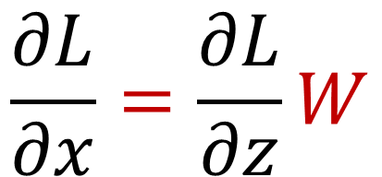
Rules: 1 (scalar)
$$z=Wx$$
All terms are scalars
$\frac{∂L}{∂z}$ is known
$$\frac{∂L}{∂x}=\frac{∂L}{∂z}W$$
$$\frac{∂L}{∂W}=x\frac{∂L}{∂z}$$

Slide 5
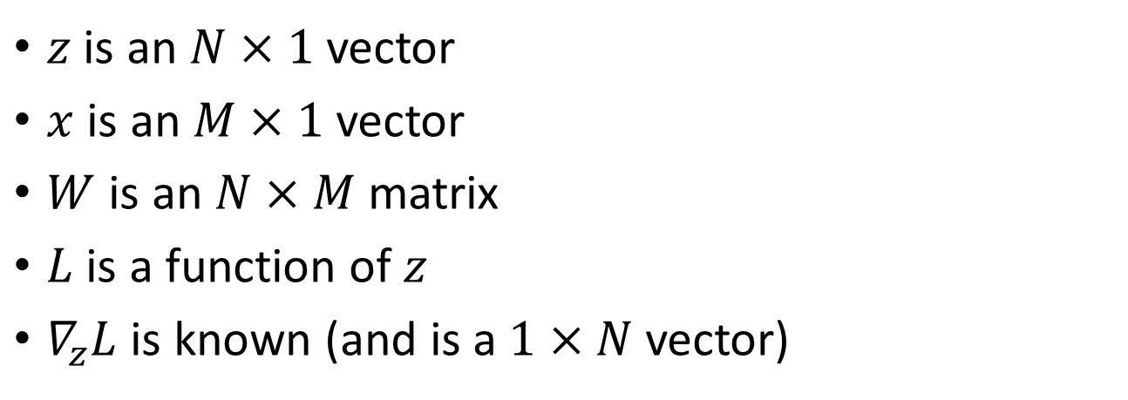
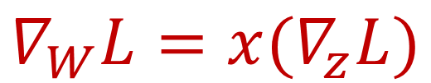

Rules: 1 (vector)
$$z=Wx$$
$z$ is an $N×1$ vector
$x$ is an $M×1$ vector
$W$ is an $N×M$ matrix
$L$ is a function of $z$
$∇_{z}L$ is known (and is a $1×N$ vector)
$$∇_{x}L={(∇}_{z}L)W$$
Please verify that the dimensions match!
$$∇_{W}L={x(∇}_{z}L)$$

Slide 6
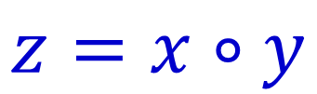
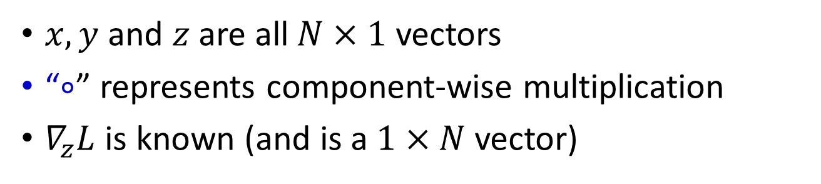
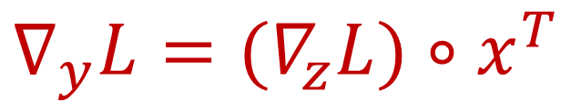

Rules: 2 (vector, schur multiply)
$$z=x∘y$$
$x, y$ and $z$ are all $N×1$ vectors
“$∘$” represents component-wise multiplication
$∇_{z}L$ is known (and is a $1×N$ vector)
$$∇_{x}L={(∇}_{z}L)∘y^{T}$$
$$∇_{y}L={(∇}_{z}L)∘x^{T}$$
Please verify that the dimensions match!

Slide 7
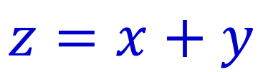
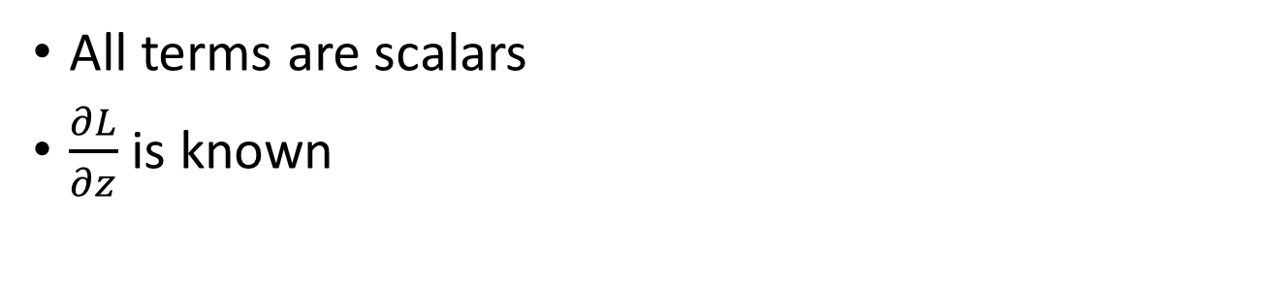
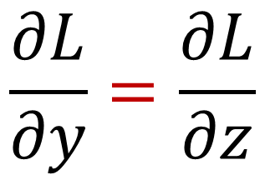

Rules: 3 (scalar)
$$z=x+y$$
All terms are scalars
$\frac{∂L}{∂z}$ is known
$$\frac{∂L}{∂x}=\frac{∂L}{∂z}$$
$$\frac{∂L}{∂y}=\frac{∂L}{∂z}$$

Slide 8
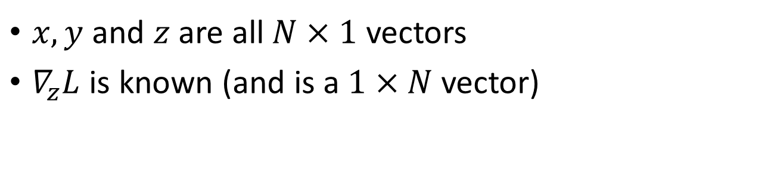
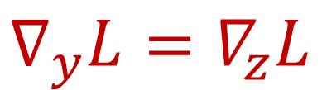
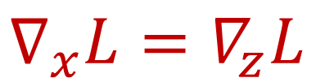
Rules: 3 (vector)
$$z=x+y$$
$x, y$ and $z$ are all $N×1$ vectors
$∇_{z}L$ is known (and is a $1×N$ vector)
$$∇_{x}L=∇_{z}L$$
$$∇_{y}L=∇_{z}L$$
Please verify that the dimensions match!

Slide 9
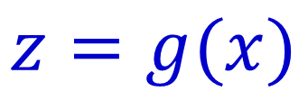
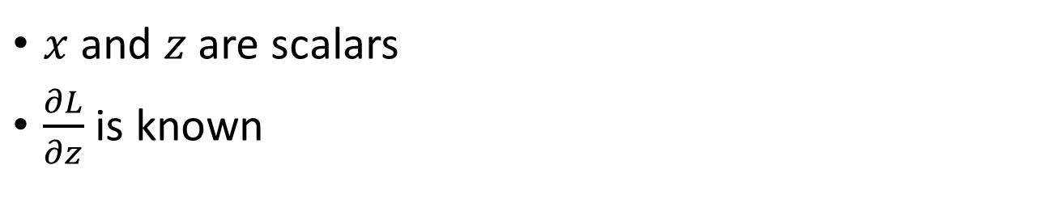
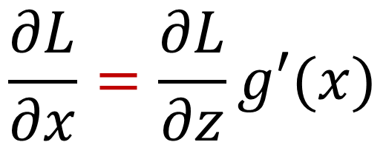
Rules: 4 (scalar)
$$z=g(x)$$
$x$ and $z$ are scalars
$\frac{∂L}{∂z}$ is known
$$\frac{∂L}{∂x}=\frac{∂L}{∂z}g′(x)$$

Slide 10
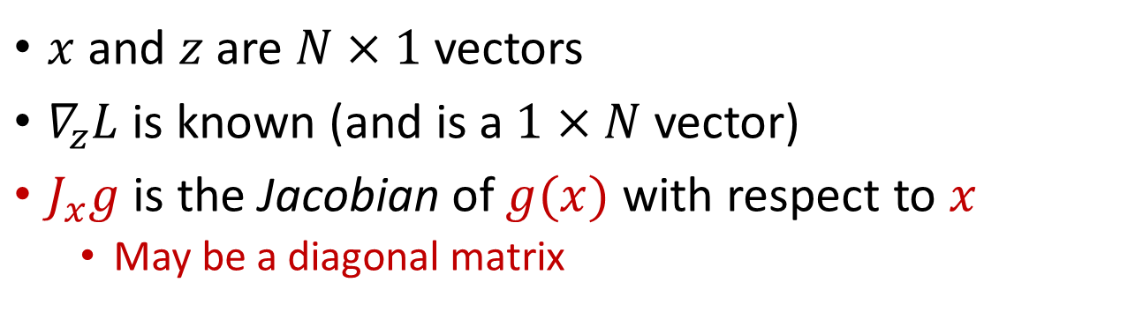
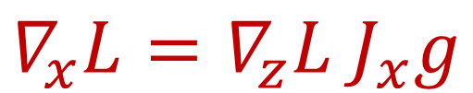
Rules: 4 (vector)
$$z=g(x)$$
$x$ and $z$ are $N×1$ vectors
$∇_{z}L$ is known (and is a $1×N$ vector)
$J_{x}g$ is the Jacobian of $g(x)$ with respect to $x$
May be a diagonal matrix
$$∇_{x}L=∇_{z}L{ J}_{x}g$$
Please verify that the dimensions match!

Slide 11
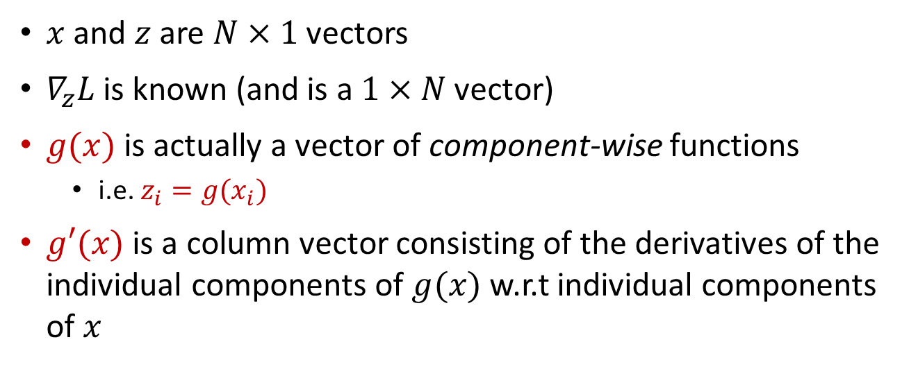
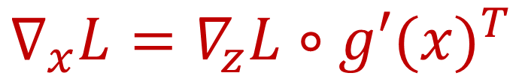
Rules: 4b (vector) component-wise multiply notation
$$z=g(x)$$
$x$ and $z$ are $N×1$ vectors
$∇_{z}L$ is known (and is a $1×N$ vector)
$g(x)$ is actually a vector of component-wise functions
i.e. $z_{i}=g(x_{i})$
$g′(x)$ is a column vector consisting of the derivatives of the individual components of $g(x)$ w.r.t individual components of $x$
$$∇_{x}L=∇_{z}L∘{g′(x)}^{T}$$
Please verify that the dimensions match!

Slide 12
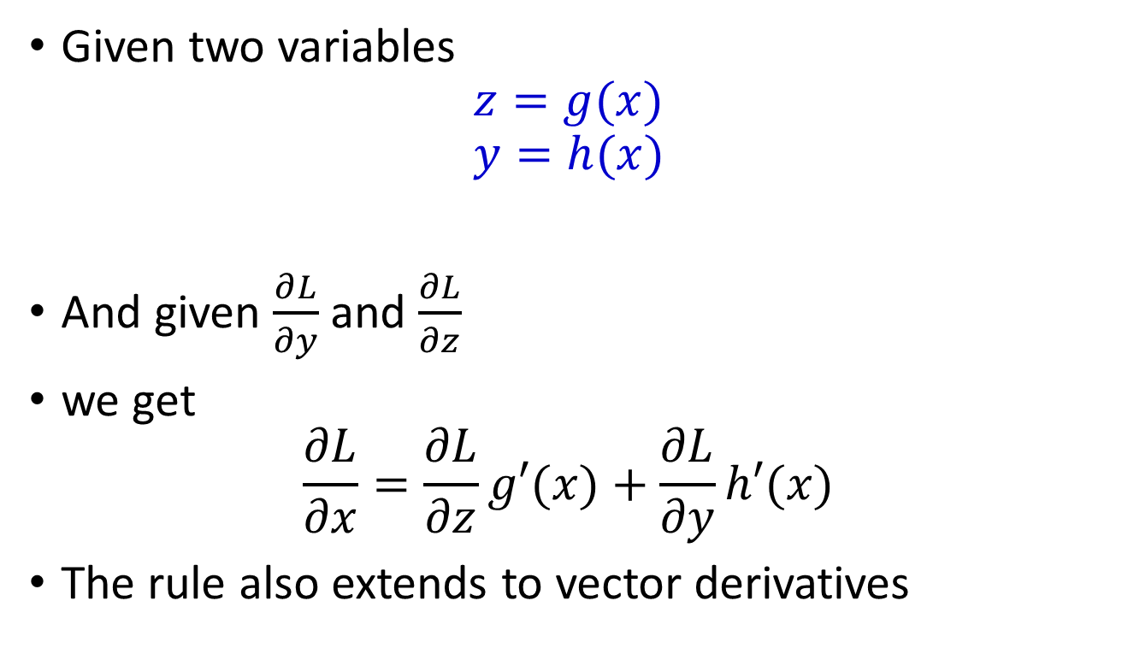
Rule 5: Addition of derivatives
Given two variables
$$z=g(x)$$
$$y=h(x)$$
And given $\frac{∂L}{∂y}$ and $\frac{∂L}{∂z}$
we get
$$\frac{∂L}{∂x}=\frac{∂L}{∂z}g′(x)+\frac{∂L}{∂y}h′(x)$$
The rule also extends to vector derivatives

Slide 13
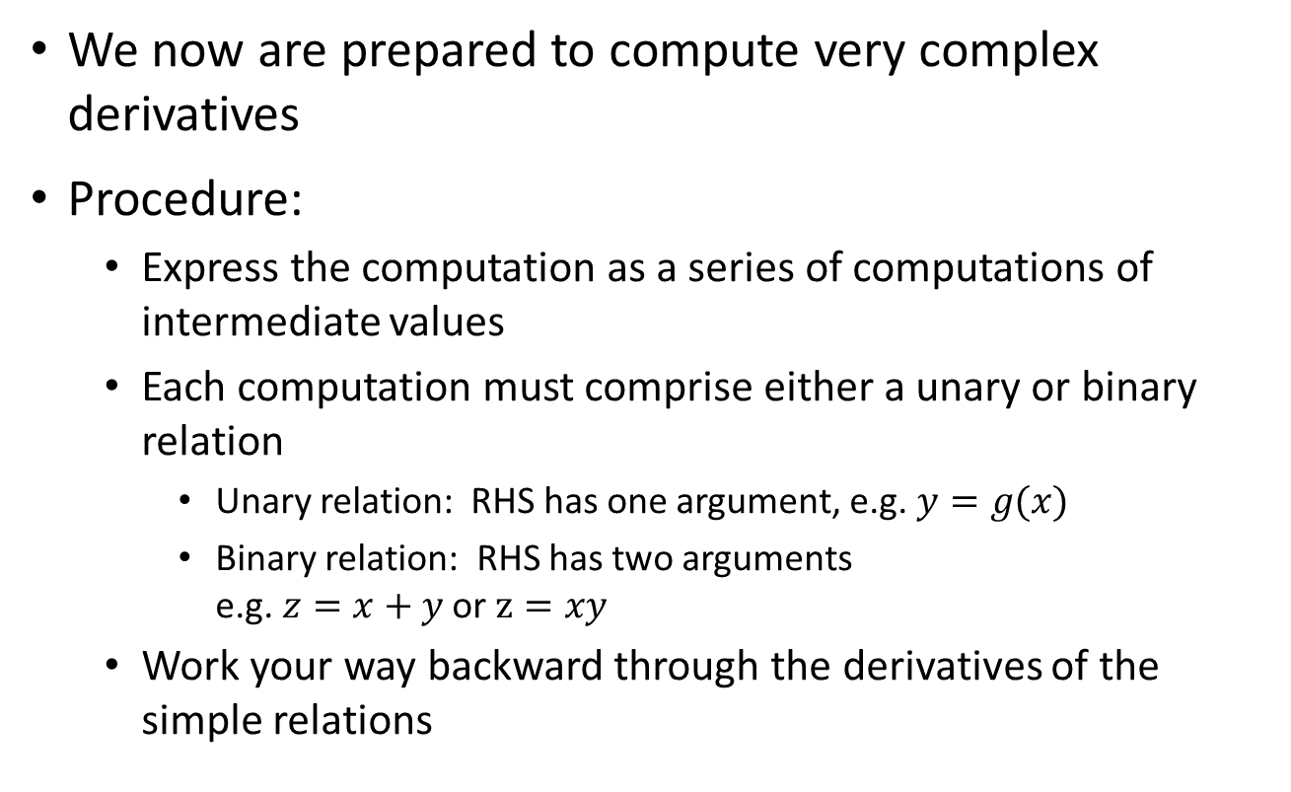
Computing derivatives of complex functions
We now are prepared to compute very complex derivatives
Procedure:
Express the computation as a series of computations of intermediate values
Each computation must comprise either a unary or binary relation
Unary relation: RHS has one argument, e.g. $y=g(x)$
Binary relation: RHS has two arguments e.g. $z=x+y$ or $z=xy$
Work your way backward through the derivatives of the simple relations

Slide 14

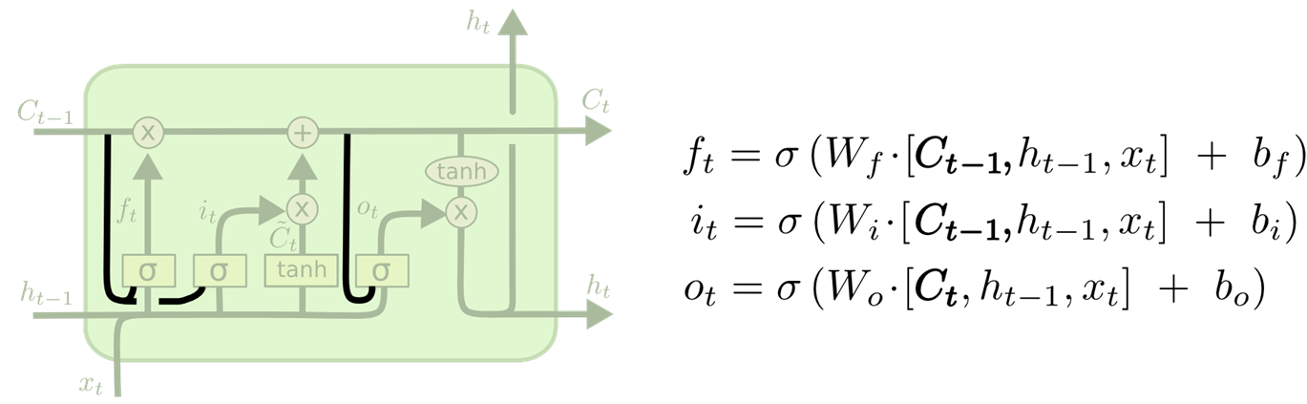
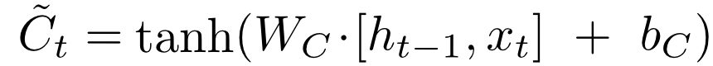
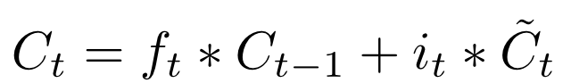
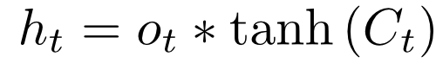
Example: LSTM
Full set of LSTM equations (in the order in which they must be computed)
1
2
3
4
5
6
Its actually much cleaner to separate the individual components, so lets do that first

Slide 15
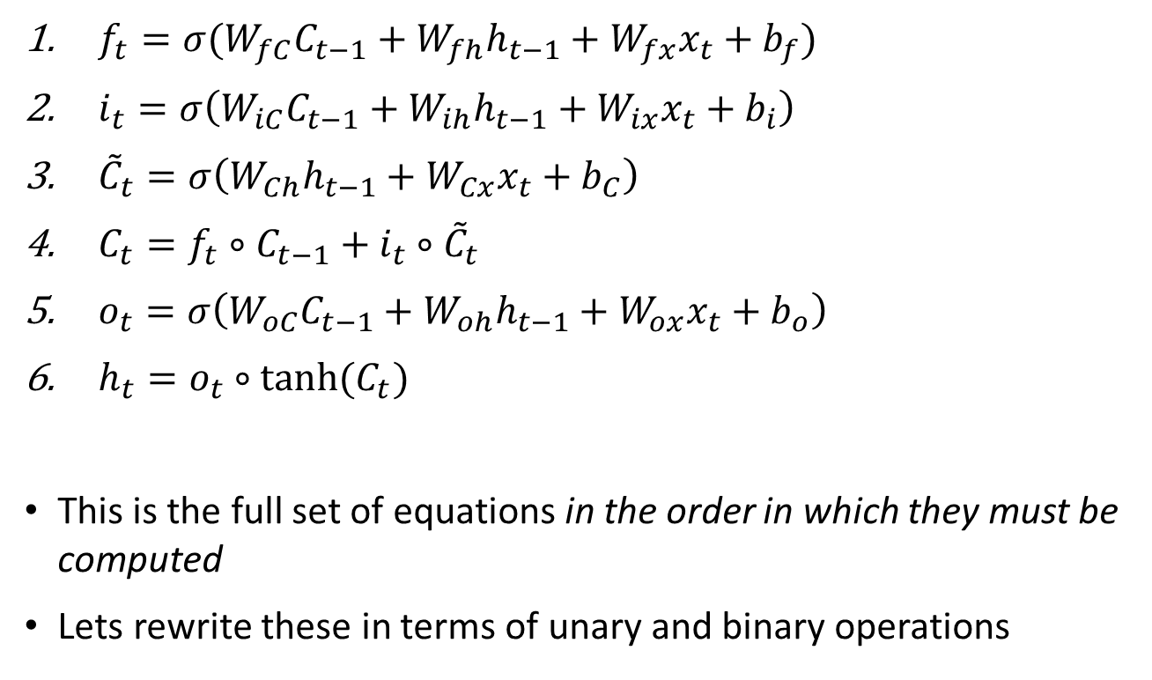
LSTM
$f_{t}=σ(W_{fC}C_{t−1}+W_{fh}h_{t−1}+W_{fx}x_{t}+b_{f})$
$i_{t}=σ\left(W_{iC}C_{t−1}+W_{ih}h_{t−1}+W_{ix}x_{t}+b_{i}\right)$
${\tilde{C}}_{t}=σ\left(W_{Ch}h_{t−1}+W_{Cx}x_{t}+b_{C}\right)$
$C_{t}=f_{t}∘C_{t−1}+{i_{t}∘\tilde{C}}_{t}$
$o_{t}=σ\left(W_{oC}C_{t−1}+W_{oh}h_{t−1}+W_{ox}x_{t}+b_{o}\right)$
$h_{t}=o_{t}∘tanh(C_{t})$
This is the full set of equations in the order in which they must be computed
Lets rewrite these in terms of unary and binary operations

Slide 16
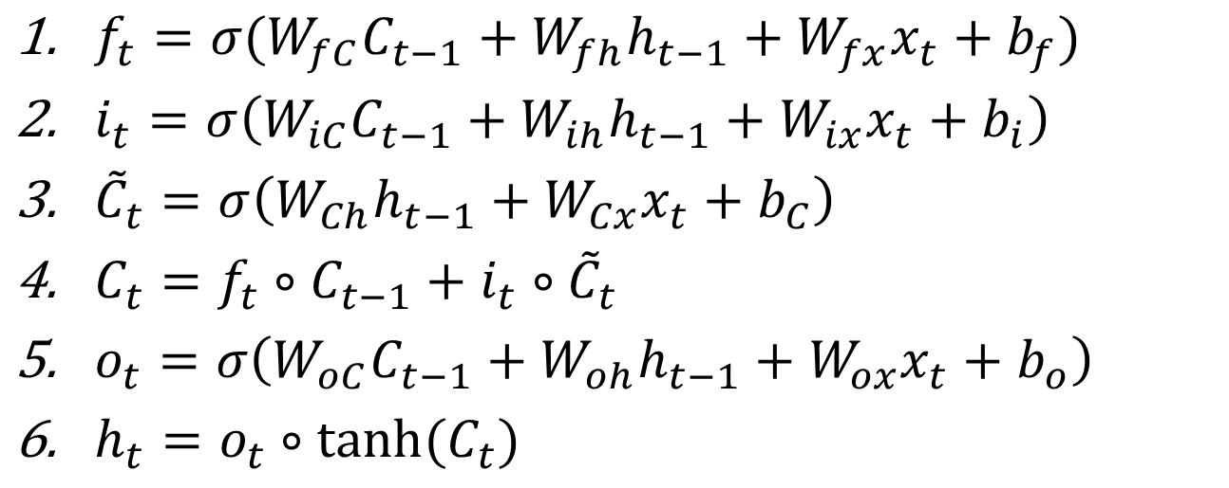
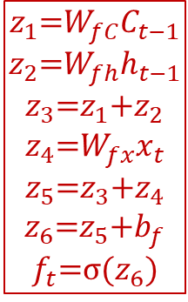
LSTM
$$z_{1}\text{=}W_{fC}C_{t−1}$$
$$z_{2}\text{=}W_{fh}h_{t−1}$$
$$z_{3}\text{=}z_{1}\text{+}z_{2}$$
$$z_{4}\text{=}W_{fx}x_{t}$$
$$z_{5}\text{=}z_{3}\text{+}z_{4}$$
$$z_{6}\text{=}z_{5}\text{+}b_{f}$$
$$f_{t}\text{=}σ(z_{6})$$
Lets rewrite these in terms of unary and binary operations

Slide 17
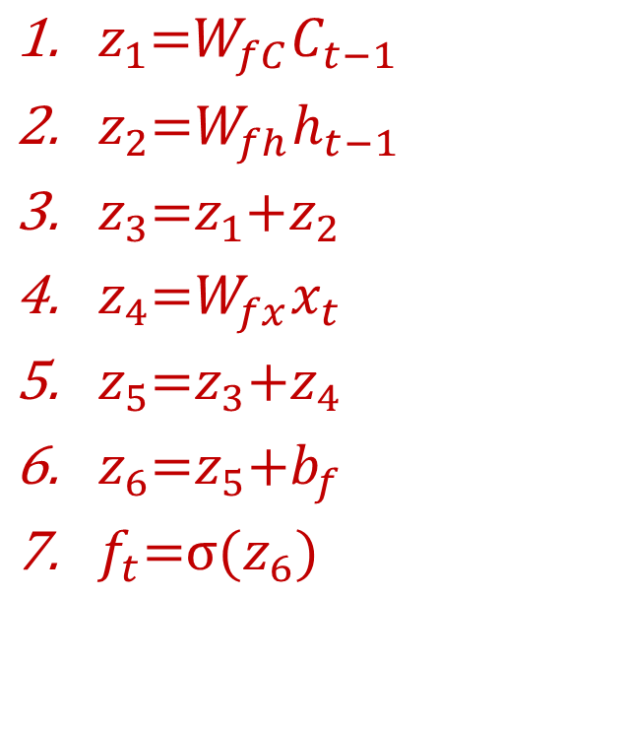
LSTM
$z_{1}\text{=}W_{fC}C_{t−1}$
$z_{2}\text{=}W_{fh}h_{t−1}$
$z_{3}\text{=}z_{1}\text{+}z_{2}$
$z_{4}\text{=}W_{fx}x_{t}$
$z_{5}\text{=}z_{3}\text{+}z_{4}$
$z_{6}\text{=}z_{5}\text{+}b_{f}$
$f_{t}\text{=}σ(z_{6})$

Slide 18
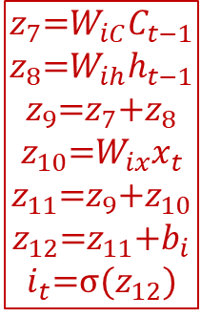
LSTM
$$z_{7}\text{=}W_{iC}C_{t−1}$$
$$z_{8}\text{=}W_{ih}h_{t−1}$$
$$z_{9}\text{=}z_{7}\text{+}z_{8}$$
$$z_{10}\text{=}W_{ix}x_{t}$$
$$z_{11}\text{=}z_{9}\text{+}z_{10}$$
$$z_{12}\text{=}z_{11}\text{+}b_{i}$$
$$i_{t}\text{=}σ(z_{12})$$
Lets rewrite these in terms of unary and binary operations

Slide 19
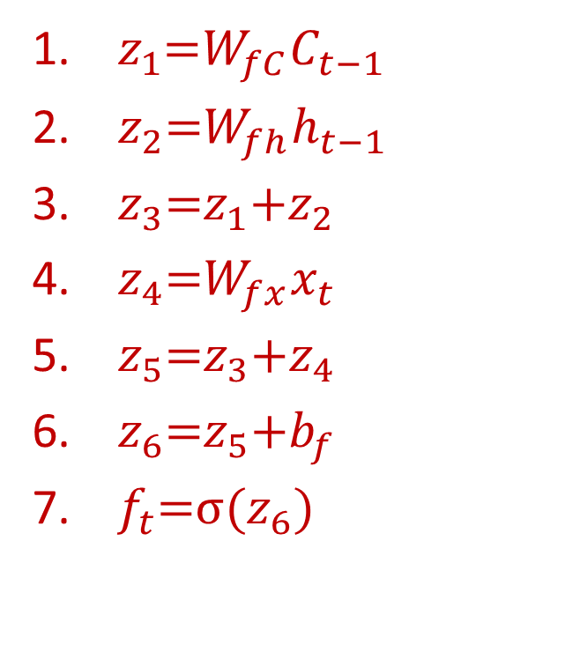
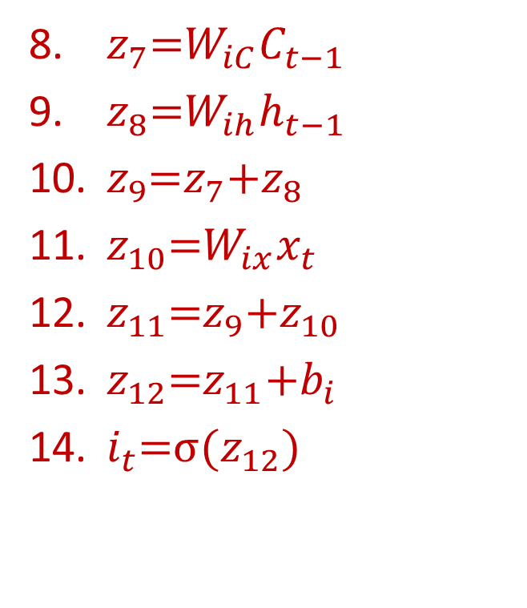
LSTM
$z_{1}\text{=}W_{fC}C_{t−1}$
$z_{2}\text{=}W_{fh}h_{t−1}$
$z_{3}\text{=}z_{1}\text{+}z_{2}$
$z_{4}\text{=}W_{fx}x_{t}$
$z_{5}\text{=}z_{3}\text{+}z_{4}$
$z_{6}\text{=}z_{5}\text{+}b_{f}$
$f_{t}\text{=}σ(z_{6})$
$z_{7}\text{=}W_{iC}C_{t−1}$
$z_{8}\text{=}W_{ih}h_{t−1}$
$z_{9}\text{=}z_{7}\text{+}z_{8}$
$z_{10}\text{=}W_{ix}x_{t}$
$z_{11}\text{=}z_{9}\text{+}z_{10}$
$z_{12}\text{=}z_{11}\text{+}b_{i}$
$i_{t}\text{=}σ(z_{12})$

Slide 20
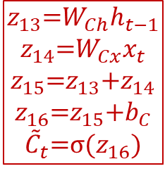
LSTM
$$z_{13}\text{=}W_{Ch}h_{t−1}$$
$$z_{14}\text{=}W_{Cx}x_{t}$$
$$z_{15}\text{=}z_{13}\text{+}z_{14}$$
$$z_{16}\text{=}z_{15}\text{+}b_{C}$$
$${\tilde{C}}_{t}\text{=}σ(z_{16})$$
Lets rewrite these in terms of unary and binary operations

Slide 21
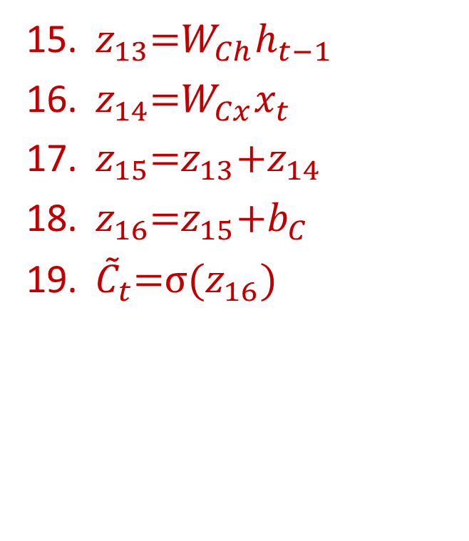
LSTM
$z_{13}\text{=}W_{Ch}h_{t−1}$
$z_{14}\text{=}W_{Cx}x_{t}$
$z_{15}\text{=}z_{13}\text{+}z_{14}$
$z_{16}\text{=}z_{15}\text{+}b_{C}$
${\tilde{C}}_{t}\text{=}σ(z_{16})$

Slide 22
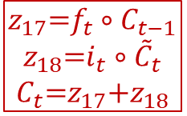
LSTM
$$z_{17}\text{=}f_{t}{∘C}_{t−1}$$
$$z_{18}\text{=}i_{t}∘{\tilde{C}}_{t}$$
$$C_{t}\text{=}z_{17}\text{+}z_{18}$$
Lets rewrite these in terms of unary and binary operations

Slide 23
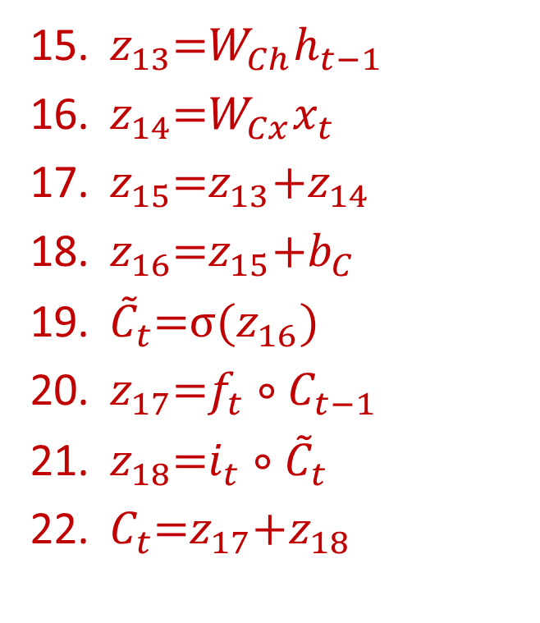
LSTM
$z_{13}\text{=}W_{Ch}h_{t−1}$
$z_{14}\text{=}W_{Cx}x_{t}$
$z_{15}\text{=}z_{13}\text{+}z_{14}$
$z_{16}\text{=}z_{15}\text{+}b_{C}$
${\tilde{C}}_{t}\text{=}σ(z_{16})$
$z_{17}\text{=}f_{t}{∘C}_{t−1}$
$z_{18}\text{=}i_{t}∘{\tilde{C}}_{t}$
$C_{t}\text{=}z_{17}\text{+}z_{18}$

Slide 24
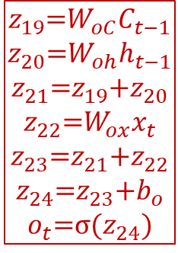
LSTM
$$z_{19}\text{=}W_{oC}C_{t−1}$$
$$z_{20}\text{=}W_{oh}h_{t−1}$$
$$z_{21}\text{=}z_{19}\text{+}z_{20}$$
$$z_{22}\text{=}W_{ox}x_{t}$$
$$z_{23}\text{=}z_{21}\text{+}z_{22}$$
$$z_{24}\text{=}z_{23}\text{+}b_{o}$$
$$o_{t}\text{=}σ(z_{24})$$
Lets rewrite these in terms of unary and binary operations

Slide 25
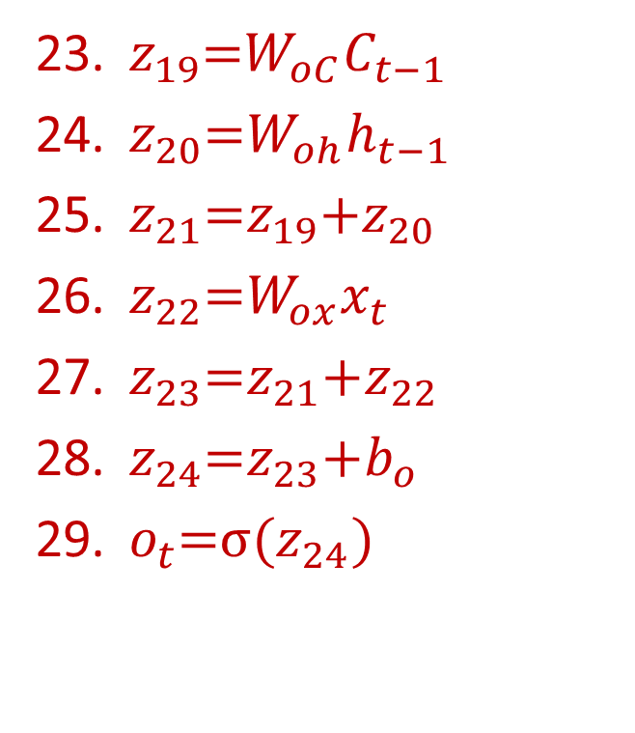
LSTM
$z_{13}\text{=}W_{Ch}h_{t−1}$
$z_{14}\text{=}W_{Cx}x_{t}$
$z_{15}\text{=}z_{13}\text{+}z_{14}$
$z_{16}\text{=}z_{15}\text{+}b_{C}$
${\tilde{C}}_{t}\text{=}σ(z_{16})$
$z_{17}\text{=}f_{t}{∘C}_{t−1}$
$z_{18}\text{=}i_{t}∘{\tilde{C}}_{t}$
$C_{t}\text{=}z_{17}\text{+}z_{18}$
$z_{19}\text{=}W_{oC}C_{t−1}$
$z_{20}\text{=}W_{oh}h_{t−1}$
$z_{21}\text{=}z_{19}\text{+}z_{20}$
$z_{22}\text{=}W_{ox}x_{t}$
$z_{23}\text{=}z_{21}\text{+}z_{22}$
$z_{24}\text{=}z_{23}\text{+}b_{o}$
$o_{t}\text{=}σ(z_{24})$

Slide 26

LSTM
$$z_{25}\text{=}tanh\left(C_{t}\right)$$
$$h_{t}=o_{t}∘z_{25}$$
Lets rewrite these in terms of unary and binary operations

Slide 27
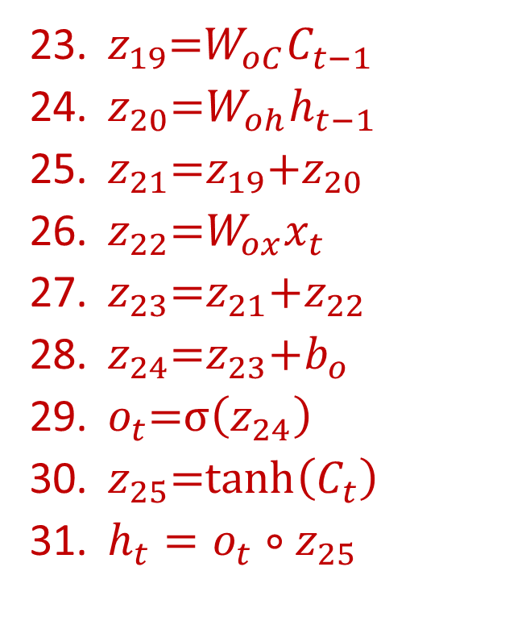
LSTM
$z_{13}\text{=}W_{Ch}h_{t−1}$
$z_{14}\text{=}W_{Cx}x_{t}$
$z_{15}\text{=}z_{13}\text{+}z_{14}$
$z_{16}\text{=}z_{15}\text{+}b_{C}$
${\tilde{C}}_{t}\text{=}σ(z_{16})$
$z_{17}\text{=}f_{t}{∘C}_{t−1}$
$z_{18}\text{=}i_{t}∘{\tilde{C}}_{t}$
$C_{t}\text{=}z_{17}\text{+}z_{18}$
$z_{19}\text{=}W_{oC}C_{t−1}$
$z_{20}\text{=}W_{oh}h_{t−1}$
$z_{21}\text{=}z_{19}\text{+}z_{20}$
$z_{22}\text{=}W_{ox}x_{t}$
$z_{23}\text{=}z_{21}\text{+}z_{22}$
$z_{24}\text{=}z_{23}\text{+}b_{o}$
$o_{t}\text{=}σ\left(z_{24}\right)$
$z_{25}\text{=}tanh\left(C_{t}\right)$
$h_{t}=o_{t}∘z_{25}$

Slide 28
LSTM forward
The full forward computation of the LSTM can be performed by computing Equations 1-31 in sequence
Every one of these equations is unary or binary

Slide 29
LSTM
$z_{1}\text{=}W_{fC}C_{t−1}$
$z_{2}\text{=}W_{fh}h_{t−1}$
$z_{3}\text{=}z_{1}\text{+}z_{2}$
$z_{4}\text{=}W_{fx}x_{t}$
$z_{5}\text{=}z_{3}\text{+}z_{4}$
$z_{6}\text{=}z_{5}\text{+}b_{f}$
$f_{t}\text{=}σ(z_{6})$
$z_{7}\text{=}W_{iC}C_{t−1}$
$z_{8}\text{=}W_{ih}h_{t−1}$
$z_{9}\text{=}z_{7}\text{+}z_{8}$
$z_{10}\text{=}W_{ix}x_{t}$
$z_{11}\text{=}z_{9}\text{+}z_{10}$
$z_{12}\text{=}z_{11}\text{+}b_{i}$
$i_{t}\text{=}σ(z_{12})$

Slide 30
LSTM
$z_{13}\text{=}W_{Ch}h_{t−1}$
$z_{14}\text{=}W_{Cx}x_{t}$
$z_{15}\text{=}z_{13}\text{+}z_{14}$
$z_{16}\text{=}z_{15}\text{+}b_{C}$
${\tilde{C}}_{t}\text{=}σ(z_{16})$
$z_{17}\text{=}f_{t}{∘C}_{t−1}$
$z_{18}\text{=}i_{t}∘{\tilde{C}}_{t}$
$C_{t}\text{=}z_{17}\text{+}z_{18}$
$z_{19}\text{=}W_{oC}C_{t−1}$
$z_{20}\text{=}W_{oh}h_{t−1}$
$z_{21}\text{=}z_{19}\text{+}z_{20}$
$z_{22}\text{=}W_{ox}x_{t}$
$z_{23}\text{=}z_{21}\text{+}z_{22}$
$z_{24}\text{=}z_{23}\text{+}b_{o}$
$o_{t}\text{=}σ\left(z_{24}\right)$
$z_{25}\text{=}tanh\left(C_{t}\right)$
$h_{t}=o_{t}∘z_{25}$

Slide 31


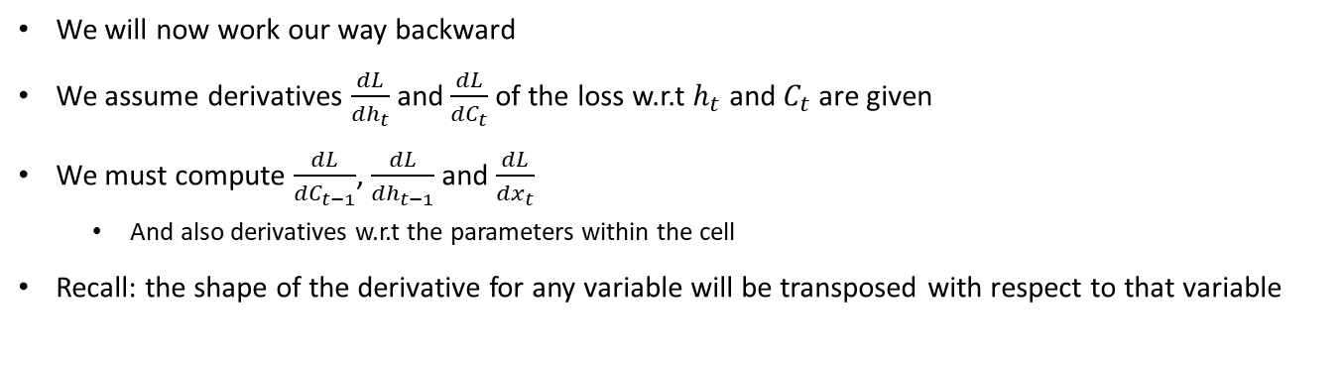





Computing derivatives
Derivative shapes:
$$Ct$$
$$W$$
$$dL/dW$$
$$C_{t−1}$$
$$C_{t}$$
$$dL/dCt$$
$$h_{t−1}$$
We will now work our way backward
We assume derivatives $\frac{dL}{dh_{t}}$ and $\frac{dL}{dC_{t}}$ of the loss w.r.t $h_{t}$ and $C_{t}$ are given
We must compute $\frac{dL}{dC_{t−1}}$, $\frac{dL}{dh_{t−1}}$ and $\frac{dL}{dx_{t}}$
And also derivatives w.r.t the parameters within the cell
Recall: the shape of the derivative for any variable will be transposed with respect to that variable

Slide 32

LSTM
$∇_{o_{t}}L=∇_{h_{t}}L∘z_{25}^{T}$
$∇_{z_{25}}L=∇_{h_{t}}L∘o_{t}^{T}$
$z_{19}\text{=}W_{oC}C_{t−1}$
$z_{20}\text{=}W_{oh}h_{t−1}$
$z_{21}\text{=}z_{19}\text{+}z_{20}$
$z_{22}\text{=}W_{ox}x_{t}$
$z_{23}\text{=}z_{21}\text{+}z_{22}$
$z_{24}\text{=}z_{23}\text{+}b_{o}$
$o_{t}\text{=}σ\left(z_{24}\right)$
$z_{25}\text{=}tanh\left(C_{t}\right)$
$h_{t}=o_{t}∘z_{25}$

Slide 33

LSTM
$∇_{o_{t}}L=∇_{h_{t}}L∘z_{25}^{T}$
$∇_{z_{25}}L=∇_{h_{t}}L∘o_{t}^{T}$
$∇_{C_{t}}L=∇_{z_{25}}L∘$ ${(1−\tanh^{2}(C_{t}))}^{T}$
$z_{19}\text{=}W_{oC}C_{t−1}$
$z_{20}\text{=}W_{oh}h_{t−1}$
$z_{21}\text{=}z_{19}\text{+}z_{20}$
$z_{22}\text{=}W_{ox}x_{t}$
$z_{23}\text{=}z_{21}\text{+}z_{22}$
$z_{24}\text{=}z_{23}\text{+}b_{o}$
$o_{t}\text{=}σ\left(z_{24}\right)$
$z_{25}\text{=}tanh\left(C_{t}\right)$
$h_{t}=o_{t}∘z_{25}$

Slide 34
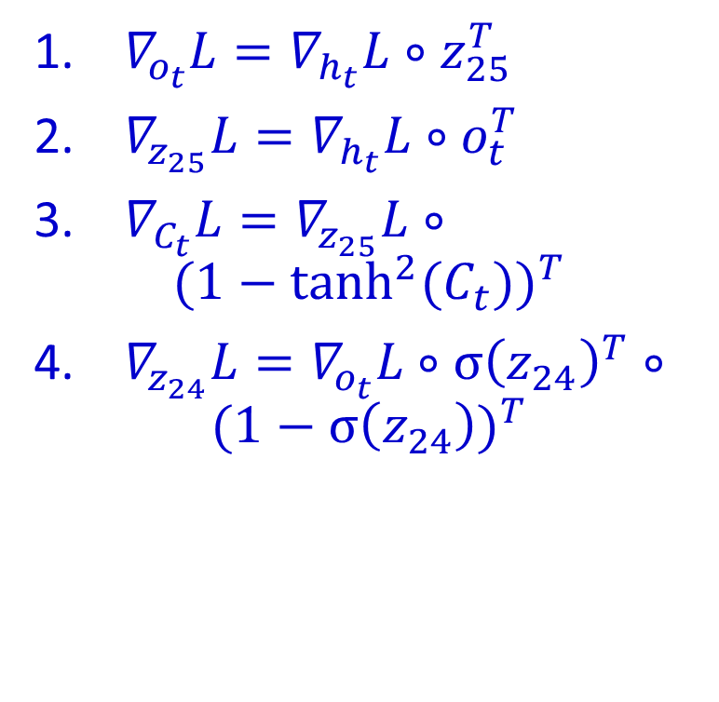
LSTM
$∇_{o_{t}}L=∇_{h_{t}}L∘z_{25}^{T}$
$∇_{z_{25}}L=∇_{h_{t}}L∘o_{t}^{T}$
$∇_{C_{t}}L=∇_{z_{25}}L∘$ ${(1−\tanh^{2}(C_{t}))}^{T}$
$∇_{z_{24}}L=∇_{o_{t}}L∘{σ\left(z_{24}\right)}^{T}∘$ ${(1−σ\left(z_{24}\right))}^{T}$
$z_{19}\text{=}W_{oC}C_{t−1}$
$z_{20}\text{=}W_{oh}h_{t−1}$
$z_{21}\text{=}z_{19}\text{+}z_{20}$
$z_{22}\text{=}W_{ox}x_{t}$
$z_{23}\text{=}z_{21}\text{+}z_{22}$
$z_{24}\text{=}z_{23}\text{+}b_{o}$
$o_{t}\text{=}σ\left(z_{24}\right)$
$z_{25}\text{=}tanh\left(C_{t}\right)$
$h_{t}=o_{t}∘z_{25}$

Slide 35
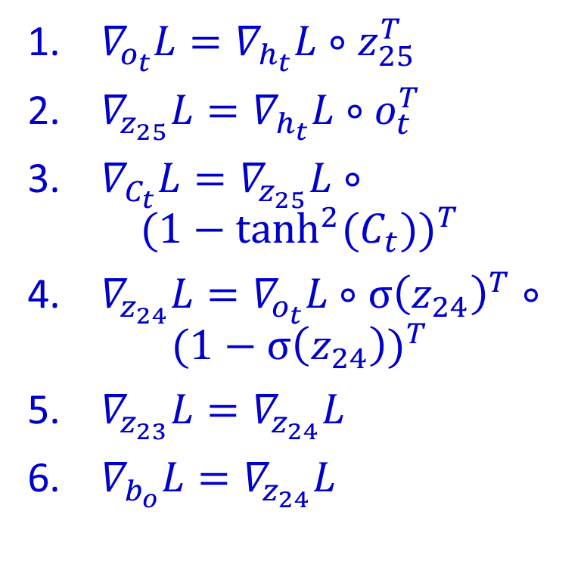
LSTM
$∇_{o_{t}}L=∇_{h_{t}}L∘z_{25}^{T}$
$∇_{z_{25}}L=∇_{h_{t}}L∘o_{t}^{T}$
$∇_{C_{t}}L=∇_{z_{25}}L∘$ ${(1−\tanh^{2}(C_{t}))}^{T}$
$∇_{z_{24}}L=∇_{o_{t}}L∘{σ\left(z_{24}\right)}^{T}∘$ ${(1−σ\left(z_{24}\right))}^{T}$
$∇_{z_{23}}L=∇_{z_{24}}L$
$∇_{b_{o}}L=∇_{z_{24}}L$
$z_{19}\text{=}W_{oC}C_{t−1}$
$z_{20}\text{=}W_{oh}h_{t−1}$
$z_{21}\text{=}z_{19}\text{+}z_{20}$
$z_{22}\text{=}W_{ox}x_{t}$
$z_{23}\text{=}z_{21}\text{+}z_{22}$
$z_{24}\text{=}z_{23}\text{+}b_{o}$
$o_{t}\text{=}σ\left(z_{24}\right)$
$z_{25}\text{=}tanh\left(C_{t}\right)$
$h_{t}=o_{t}∘z_{25}$
Equations highlighted in yellow show derivatives w.r.t. parameters

Slide 36

LSTM
$∇_{z_{22}}L=∇_{z_{23}}L$
$∇_{z_{21}}L=∇_{z_{23}}L$
$z_{19}\text{=}W_{oC}C_{t−1}$
$z_{20}\text{=}W_{oh}h_{t−1}$
$z_{21}\text{=}z_{19}\text{+}z_{20}$
$z_{22}\text{=}W_{ox}x_{t}$
$z_{23}\text{=}z_{21}\text{+}z_{22}$
$z_{24}\text{=}z_{23}\text{+}b_{o}$
$o_{t}\text{=}σ\left(z_{24}\right)$
$z_{25}\text{=}tanh\left(C_{t}\right)$
$h_{t}=o_{t}∘z_{25}$

Slide 37

LSTM
$∇_{z_{22}}L=∇_{z_{23}}L$
$∇_{z_{21}}L=∇_{z_{23}}L$
$∇_{W_{ox}}L=x_{t}∇_{z_{22}}L$
$∇_{x_{t}}L=∇_{z_{22}}LW_{ox}$
$z_{19}\text{=}W_{oC}C_{t−1}$
$z_{20}\text{=}W_{oh}h_{t−1}$
$z_{21}\text{=}z_{19}\text{+}z_{20}$
$z_{22}\text{=}W_{ox}x_{t}$
$z_{23}\text{=}z_{21}\text{+}z_{22}$
$z_{24}\text{=}z_{23}\text{+}b_{o}$
$o_{t}\text{=}σ\left(z_{24}\right)$
$z_{25}\text{=}tanh\left(C_{t}\right)$
$h_{t}=o_{t}∘z_{25}$

Slide 38

LSTM
$∇_{z_{22}}L=∇_{z_{23}}L$
$∇_{z_{21}}L=∇_{z_{23}}L$
$∇_{W_{ox}}L=x_{t}∇_{z_{22}}L$
$∇_{x_{t}}L=∇_{z_{22}}LW_{ox}$
$∇_{z_{20}}L=∇_{z_{21}}L$
$∇_{z_{19}}L=∇_{z_{21}}L$
$z_{19}\text{=}W_{oC}C_{t−1}$
$z_{20}\text{=}W_{oh}h_{t−1}$
$z_{21}\text{=}z_{19}\text{+}z_{20}$
$z_{22}\text{=}W_{ox}x_{t}$
$z_{23}\text{=}z_{21}\text{+}z_{22}$
$z_{24}\text{=}z_{23}\text{+}b_{o}$
$o_{t}\text{=}σ\left(z_{24}\right)$
$z_{25}\text{=}tanh\left(C_{t}\right)$
$h_{t}=o_{t}∘z_{25}$

Slide 39

LSTM
$∇_{z_{22}}L=∇_{z_{23}}L$
$∇_{z_{21}}L=∇_{z_{23}}L$
$∇_{W_{ox}}L=x_{t}∇_{z_{22}}L$
$∇_{x_{t}}L=∇_{z_{22}}LW_{ox}$
$∇_{z_{20}}L=∇_{z_{21}}L$
$∇_{z_{19}}L=∇_{z_{21}}L$
$∇_{W_{oh}}L=h_{t−1}∇_{z_{20}}L$
$∇_{h_{t−1}}L=∇_{z_{20}}LW_{oh}$
$z_{19}\text{=}W_{oC}C_{t−1}$
$z_{20}\text{=}W_{oh}h_{t−1}$
$z_{21}\text{=}z_{19}\text{+}z_{20}$
$z_{22}\text{=}W_{ox}x_{t}$
$z_{23}\text{=}z_{21}\text{+}z_{22}$
$z_{24}\text{=}z_{23}\text{+}b_{o}$
$o_{t}\text{=}σ\left(z_{24}\right)$
$z_{25}\text{=}tanh\left(C_{t}\right)$
$h_{t}=o_{t}∘z_{25}$

Slide 40

LSTM
$∇_{z_{22}}L=∇_{z_{23}}L$
$∇_{z_{21}}L=∇_{z_{23}}L$
$∇_{W_{ox}}L=x_{t}∇_{z_{22}}L$
$∇_{x_{t}}L=∇_{z_{22}}LW_{ox}$
$∇_{z_{20}}L=∇_{z_{21}}L$
$∇_{z_{19}}L=∇_{z_{21}}L$
$∇_{W_{oh}}L=h_{t−1}∇_{z_{20}}L$
$∇_{h_{t−1}}L=∇_{z_{20}}LW_{oh}$
$∇_{W_{oC}}L=C_{t−1}∇_{z_{19}}L$
$∇_{C_{t−1}}L=∇_{z_{19}}LW_{oC}$
$z_{19}\text{=}W_{oC}C_{t−1}$
$z_{20}\text{=}W_{oh}h_{t−1}$
$z_{21}\text{=}z_{19}\text{+}z_{20}$
$z_{22}\text{=}W_{ox}x_{t}$
$z_{23}\text{=}z_{21}\text{+}z_{22}$
$z_{24}\text{=}z_{23}\text{+}b_{o}$
$o_{t}\text{=}σ\left(z_{24}\right)$
$z_{25}\text{=}tanh\left(C_{t}\right)$
$h_{t}=o_{t}∘z_{25}$

Slide 41

LSTM
$z_{13}\text{=}W_{Ch}h_{t−1}$
$z_{14}\text{=}W_{Cx}x_{t}$
$z_{15}\text{=}z_{13}\text{+}z_{14}$
$z_{16}\text{=}z_{15}\text{+}b_{C}$
${\tilde{C}}_{t}\text{=}σ(z_{16})$
$z_{17}\text{=}f_{t}{∘C}_{t−1}$
$z_{18}\text{=}i_{t}∘{\tilde{C}}_{t}$
$C_{t}\text{=}z_{17}\text{+}z_{18}$
$∇_{z_{18}}L=∇_{C_{t}}L$
$∇_{z_{17}}L=∇_{C_{t}}L$

Slide 42

LSTM
$z_{13}\text{=}W_{Ch}h_{t−1}$
$z_{14}\text{=}W_{Cx}x_{t}$
$z_{15}\text{=}z_{13}\text{+}z_{14}$
$z_{16}\text{=}z_{15}\text{+}b_{C}$
${\tilde{C}}_{t}\text{=}σ(z_{16})$
$z_{17}\text{=}f_{t}{∘C}_{t−1}$
$z_{18}\text{=}i_{t}∘{\tilde{C}}_{t}$
$C_{t}\text{=}z_{17}\text{+}z_{18}$
$∇_{z_{18}}L=∇_{C_{t}}L$
$∇_{z_{17}}L=∇_{C_{t}}L$
$∇_{i_{t}}L=∇_{z_{18}}L∘{\tilde{C}}_{t}^{T}$
$∇_{{\tilde{C}}_{t}}L=∇_{z_{18}}L∘i_{t}^{T}$

Slide 43

LSTM
$z_{13}\text{=}W_{Ch}h_{t−1}$
$z_{14}\text{=}W_{Cx}x_{t}$
$z_{15}\text{=}z_{13}\text{+}z_{14}$
$z_{16}\text{=}z_{15}\text{+}b_{C}$
${\tilde{C}}_{t}\text{=}σ(z_{16})$
$z_{17}\text{=}f_{t}{∘C}_{t−1}$
$z_{18}\text{=}i_{t}∘{\tilde{C}}_{t}$
$C_{t}\text{=}z_{17}\text{+}z_{18}$
$∇_{z_{18}}L=∇_{C_{t}}L$
$∇_{z_{17}}L=∇_{C_{t}}L$
$∇_{i_{t}}L=∇_{z_{18}}L∘{\tilde{C}}_{t}^{T}$
$∇_{{\tilde{C}}_{t}}L=∇_{z_{18}}L∘i_{t}^{T}$
$∇_{C_{t−1}}L+=∇_{z_{17}}L∘f_{t}^{T}$
$∇_{f_{t}}L=∇_{z_{17}}L∘C_{t−1}^{T}$
Second time we’re computing a derivative for C_{t-1}, so we increment the derivative (“+=“)

Slide 44

LSTM
$z_{13}\text{=}W_{Ch}h_{t−1}$
$z_{14}\text{=}W_{Cx}x_{t}$
$z_{15}\text{=}z_{13}\text{+}z_{14}$
$z_{16}\text{=}z_{15}\text{+}b_{C}$
${\tilde{C}}_{t}\text{=}σ(z_{16})$
$z_{17}\text{=}f_{t}{∘C}_{t−1}$
$z_{18}\text{=}i_{t}∘{\tilde{C}}_{t}$
$C_{t}\text{=}z_{17}\text{+}z_{18}$
$∇_{z_{18}}L=∇_{C_{t}}L$
$∇_{z_{17}}L=∇_{C_{t}}L$
$∇_{i_{t}}L=∇_{z_{18}}L∘{\tilde{C}}_{t}^{T}$
$∇_{{\tilde{C}}_{t}}L=∇_{z_{18}}L∘i_{t}^{T}$
$∇_{C_{t−1}}L+=∇_{z_{17}}L∘f_{t}^{T}$
$∇_{f_{t}}L=∇_{z_{17}}L∘C_{t−1}^{T}$
$∇_{z_{16}}L=∇_{{\tilde{C}}_{t}}L∘{σ\left(z_{16}\right)}^{T}∘$ ${(1−σ\left(z_{16}\right))}^{T}$

Slide 45

LSTM
$z_{13}\text{=}W_{Ch}h_{t−1}$
$z_{14}\text{=}W_{Cx}x_{t}$
$z_{15}\text{=}z_{13}\text{+}z_{14}$
$z_{16}\text{=}z_{15}\text{+}b_{C}$
${\tilde{C}}_{t}\text{=}σ(z_{16})$
$z_{17}\text{=}f_{t}{∘C}_{t−1}$
$z_{18}\text{=}i_{t}∘{\tilde{C}}_{t}$
$C_{t}\text{=}z_{17}\text{+}z_{18}$
$∇_{b_{C}}L=∇_{z_{16}}L$
$∇_{z_{15}}L=∇_{z_{16}}L$

Slide 46

LSTM
$z_{13}\text{=}W_{Ch}h_{t−1}$
$z_{14}\text{=}W_{Cx}x_{t}$
$z_{15}\text{=}z_{13}\text{+}z_{14}$
$z_{16}\text{=}z_{15}\text{+}b_{C}$
${\tilde{C}}_{t}\text{=}σ(z_{16})$
$z_{17}\text{=}f_{t}{∘C}_{t−1}$
$z_{18}\text{=}i_{t}∘{\tilde{C}}_{t}$
$C_{t}\text{=}z_{17}\text{+}z_{18}$
$∇_{b_{C}}L=∇_{z_{16}}L$
$∇_{z_{15}}L=∇_{z_{16}}L$
$∇_{b_{C}}L=∇_{z_{16}}L$
$∇_{z_{15}}L=∇_{z_{16}}L$

Slide 47

LSTM
$z_{13}\text{=}W_{Ch}h_{t−1}$
$z_{14}\text{=}W_{Cx}x_{t}$
$z_{15}\text{=}z_{13}\text{+}z_{14}$
$z_{16}\text{=}z_{15}\text{+}b_{C}$
${\tilde{C}}_{t}\text{=}σ(z_{16})$
$z_{17}\text{=}f_{t}{∘C}_{t−1}$
$z_{18}\text{=}i_{t}∘{\tilde{C}}_{t}$
$C_{t}\text{=}z_{17}\text{+}z_{18}$
$∇_{b_{C}}L=∇_{z_{16}}L$
$∇_{z_{15}}L=∇_{z_{16}}L$
$∇_{b_{C}}L=∇_{z_{16}}L$
$∇_{z_{15}}L=∇_{z_{16}}L$
$∇_{W_{Cx}}L=x_{t}∇_{z_{14}}L$
$∇_{x_{t}}L+=∇_{z_{14}}LW_{Cx}$
Note the “+=“

Slide 48

LSTM
$z_{13}\text{=}W_{Ch}h_{t−1}$
$z_{14}\text{=}W_{Cx}x_{t}$
$z_{15}\text{=}z_{13}\text{+}z_{14}$
$z_{16}\text{=}z_{15}\text{+}b_{C}$
${\tilde{C}}_{t}\text{=}σ(z_{16})$
$z_{17}\text{=}f_{t}{∘C}_{t−1}$
$z_{18}\text{=}i_{t}∘{\tilde{C}}_{t}$
$C_{t}\text{=}z_{17}\text{+}z_{18}$
$∇_{b_{C}}L=∇_{z_{16}}L$
$∇_{z_{15}}L=∇_{z_{16}}L$
$∇_{b_{C}}L=∇_{z_{16}}L$
$∇_{z_{15}}L=∇_{z_{16}}L$
$∇_{W_{Cx}}L=x_{t}∇_{z_{14}}L$
$∇_{x_{t}}L+=∇_{z_{14}}LW_{Cx}$
$∇_{W_{Ch}}L=h_{t−1}∇_{z_{14}}L$
$∇_{h_{t−1}}L+=∇_{z_{13}}LW_{Ch}$
Note the “+=“

Slide 49
Continuing the computation
Continue the backward progression until the derivatives from forward Equation 1 have been computed
At this point all derivatives will be computed.

Slide 50
Overall procedure
Express the overall computation as a sequence of unary or binary operations
Can be automated
Computes derivatives incrementally, going backward over the sequence of equations!
Since each atomic computation is simple and belongs to one of a small set of possibilities, the conversion to derivatives is trivial once the computation is serialized as above

Slide 51

May be easier to think of it in terms of a “derivative” routine
Define a routine that returns derivatives for unary and binary operations
SCALAR version (all variables are scalars)
function deriv(dz, x, y, operator)
case operator:
‘none’ : return dx
‘$∗$’ : return y*dz, dz*x
‘+’ : return dz, dz
‘-’ : return dz, -dz
# Single argument operations
‘tanh’ : return dz(1-tanh²(x))
‘sigmoid’ : return dz sigmoid(x) (1-sigmoid(x))

Slide 52

Derivative routine, vector version
Note distinction between component-wise and matrix multiplies
Observe also that matrix and vector dimensions are correctly handled (locally)
“$∘$” is component-wise multiply
“*” is matrix multiply
function deriv(dz, x, y, operator)
case operator:
‘none’ : return dx
# component-wise “schur” multiply
‘$∘$’ : return dz $∘$y^{T}, dz $∘$x^{T}
# Matrix multiply. X must be a matrix
‘$∗$’ : return y*dz, dz*x
‘+’ : return dz, dz
‘-’ : return dz, -dz
# The following will expect a single argument
‘tanh’ : return dz $∘$(1-tanh²(x))^{T}
‘sigmoid’ : return dz $∘$sigmoid(x)^{T} $∘$(1-sigmoid(x))^{T}
# The jacobian is the full derivative matrix of the sigmoid
‘softmax’ : return dz*Jacobian(sigmoid,x)

Slide 53
When to use “=“ vs “+=“
In the forward computation a variable may be used multiple times to compute other intermediate variables
During backward computations, the first time the derivative is computed for the variable, the we will use “=“
In subsequent computations we use “+=“
It may be difficult to keep track of when we first compute the derivative for a variable
When to use “=“ vs when to use “+=“
Cheap trick:
Initialize all derivatives to 0 during computation
Always use “+=“
You will get the correct answer (why?)

Slide 54


[dC_{t-1},dx_{t},dh_{t-1},d[W,b]] = LSTM_derivative(dC_{t} dh_{t})
initialize d(variable)=0 (all variables)
# Derivative of eq. 31 $h_{t}=o_{t}∘z_{25}$
[do_{t}, dz₂₅] += deriv(dh_{t},o_{t},z₂₅,’$∘$’)
# Derivative of eq. 30 $z_{25}\text{=}tanh\left(C_{t}\right)$
[dC_{t}] += deriv(dz₂₅,C_{t},’tanh’)
# Derivative of eq. 29 $o_{t}\text{=}σ\left(z_{24}\right)$
[dz₂₅] += deriv(do_{t},z₂₅,’sigmoid’)
# Derivative of eq. 28 $z_{24}\text{=}z_{23}\text{+}b_{o}$
[dz₂₃, db_{o}] += deriv(dz₂₄,z₂₃,b_{o},’+’)
# Derivative of eq. 27 $z_{23}\text{=}z_{21}\text{+}z_{22}$
[dz₂₁, dz₂₂] += deriv(dz₂₃,z₂₁,z₂₂,’+’)
# Derivative of eq. 26 $z_{22}\text{=}W_{ox}x_{t}$
[dW_{ox}, dx_{t}] += deriv(dz₂₂,W_{ox},x_{t},’*’)
# Derivative of eq. 25 $z_{21}\text{=}z_{19}\text{+}z_{20}$
[dz₁₉, dz₂₀] += deriv(dz₂₁,z₁₉,z₂₀,’+’)
# Derivative of eq. 24 $z_{20}\text{=}W_{oh}h_{t−1}$
[dW_{oh}, dh_{t-1}] += deriv(dz₂₀,W_{oh},h_{t-1},’*’)
# Derivative of eq. 23 $z_{19}\text{=}W_{oC}C_{t−1}$
[dW_{oC}, dC_{t-1}] += deriv(dz₁₉,W_{oC},C_{t-1},’*’)

Slide 55


… continued from previous slide
# Derivative of eq. 22 $C_{t}\text{=}z_{17}\text{+}z_{18}$
[dz₁₇, dz₁₈] += deriv(dC_{t},z₁₈,z₁₈,’$+$’)
# Derivative of eq. 21 $z_{18}\text{=}i_{t}∘{\tilde{C}}_{t}$
[di_{t}, dtildeC_{t}] += deriv(dz₁₈,i_{t}, dtildeC_{t},’$∘$’)
# Derivative of eq. 20 $z_{17}\text{=}f_{t}{∘C}_{t−1}$
[df_{t}, dC_{t-1}] += deriv(dz₁₇,f_{t},C_{t-1},’$∘$’)
# Derivative of eq. 19 ${\tilde{C}}_{t}\text{=}σ(z_{16})$
[dz₁₆] += deriv(dtildeC_{t},’sigmoid’)
# Derivative of eq. 18 $z_{16}\text{=}z_{15}\text{+}b_{C}$
[dz₁₅, db_{C}] += deriv(dz₁₆,z₁₅,b_{C},’+’)
# Derivative of eq. 17 $z_{15}\text{=}z_{13}\text{+}z_{14}$
[dz₁₃, dz₁₄] += deriv(dz₁₅,z₁₃,z₁₄,’+’)
# Derivative of eq. 16 $z_{14}\text{=}W_{Cx}x_{t}$
[dW_{Cx}, dx_{t}] += deriv(dz₁₄,W_{Cx},x_{t},’*’)
# Derivative of eq. 15 $z_{13}\text{=}W_{Ch}h_{t−1}$
[dW_{Ch}, dh_{t-1}] += deriv(dz₁₃,W_{Ch},h_{t-1},’*’)

Slide 56


… continued from previous slide
# Derivative of eq. 14 $i_{t}\text{=}σ(z_{12})$
[dz₁₂] += deriv(di_{t},’sigmoid’)
# Derivative of eq. 13 $z_{12}\text{=}z_{11}\text{+}b_{f}$
[dz₁₁, db_{i}] += deriv(dz₁₂,z₁₁, b_{i},’$+$’)
# Derivative of eq. 12 $z_{11}\text{=}z_{9}\text{+}z_{10}$
[dz₉, dz₁₀] += deriv(dz₁₁,z₉,z₁₀,’$+$’)
# Derivative of eq. 11 $z_{10}\text{=}W_{ix}x_{t}$
[dW_{ix}, dx_{t}] += deriv(dz₁₀,W_{ix},x_{t},’+’)
# Derivative of eq. 10 $z_{9}\text{=}z_{7}\text{+}z_{8}$
[dz₇, dz₈] += deriv(dz₉,z₇,z₈,’+’)
# Derivative of eq. 9 $z_{8}\text{=}W_{ih}h_{t−1}$
[dW_{ih}, dh_{t-1}] += deriv(dz₈,W_{ih},h_{t-1},’*’)
# Derivative of eq. 8 $z_{7}\text{=}W_{iC}C_{t−1}$
[dW_{iC}, dC_{t-1}] += deriv(dz₇,W_{iC},C_{t-1},’*’)

Slide 57


… continued from previous slide
# Derivative of eq. 7 $f_{t}\text{=}σ(z_{6})$
[dz₆] += deriv(df_{t},’sigmoid’)
# Derivative of eq. 6 $z_{6}\text{=}z_{5}\text{+}b_{f}$
[dz₅, db_{f}] += deriv(dz₆,z₅, b_{f},’$+$’)
# Derivative of eq. 5 $z_{5}\text{=}z_{3}\text{+}z_{4}$
[dz₃, dz₄] += deriv(dz₅,z₃,z₄,’$+$’)
# Derivative of eq. 4 $z_{4}\text{=}W_{fx}x_{t}$
[dW_{fx}, dx_{t}] += deriv(dz₄,W_{fx},x_{t},’*’)
# Derivative of eq. 3 $z_{3}\text{=}z_{1}\text{+}z_{2}$
[dz₁, dz₂] += deriv(dz₃,z₁,z₂,’+’)
# Derivative of eq. 2 $z_{2}\text{=}W_{fh}h_{t−1}$
[dW_{fh}, dh_{t-1}] += deriv(dz₂,W_{fh},h_{t-1},’*’)
# Derivative of eq. 1 $z_{1}\text{=}W_{fC}C_{t−1}$
[dW_{fC}, dC_{t-1}] += deriv(dz₇,W_{fC},C_{t-1},’*’)
return dC_{t-1}, dh_{t-1}, dx_{t}, d[W,b]

Slide 58
Caveats
The deriv() routine given is missing several operators
Operations involving constants (z = 2y, z = 1-y, z = 3+y)
Division and inversion (e.g z = x/y, z = 1/y, z = A⁻¹)
You may have to extend it to deal with these, or rewrite your equations to eliminate such operations if possible
In practice many of the operations will be grouped together for computational efficiency
And to take advantage of parallel processing capabilities
But the basic principle applies to any computation that can be expressed as a serial operation of unary and binary relations
If you can do it on a computer, you can express it as a serial operation
In fact the preceding logic is exactly what we use to compute derivatives in backprop
We saw this explicitly in the vector version of BP for MLPs.

